Slide 1
The 24th International ACM SIGACCESS Conference on Computers and Accessibility
Athens, Greece
Oct 23-26
Notes:
Good morning!
Kaliméra – Cali-mera

Slide 2
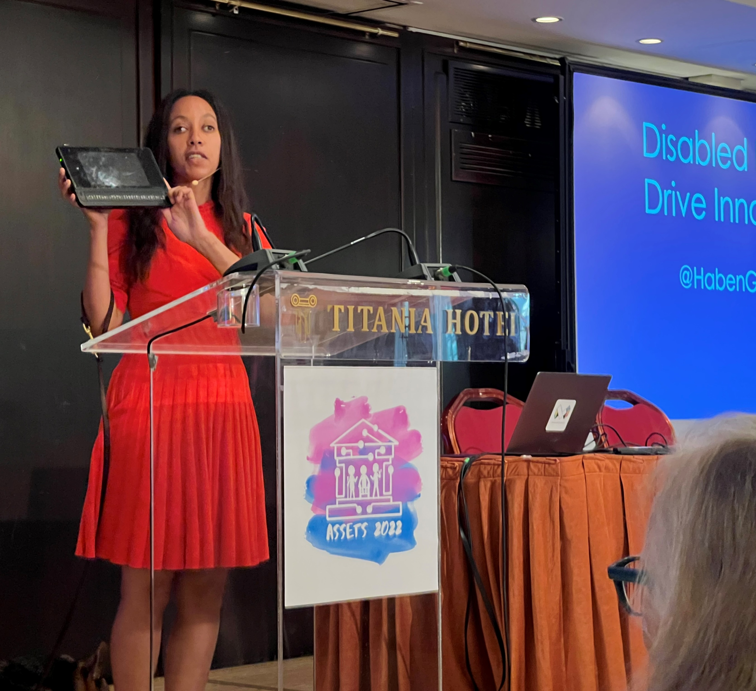
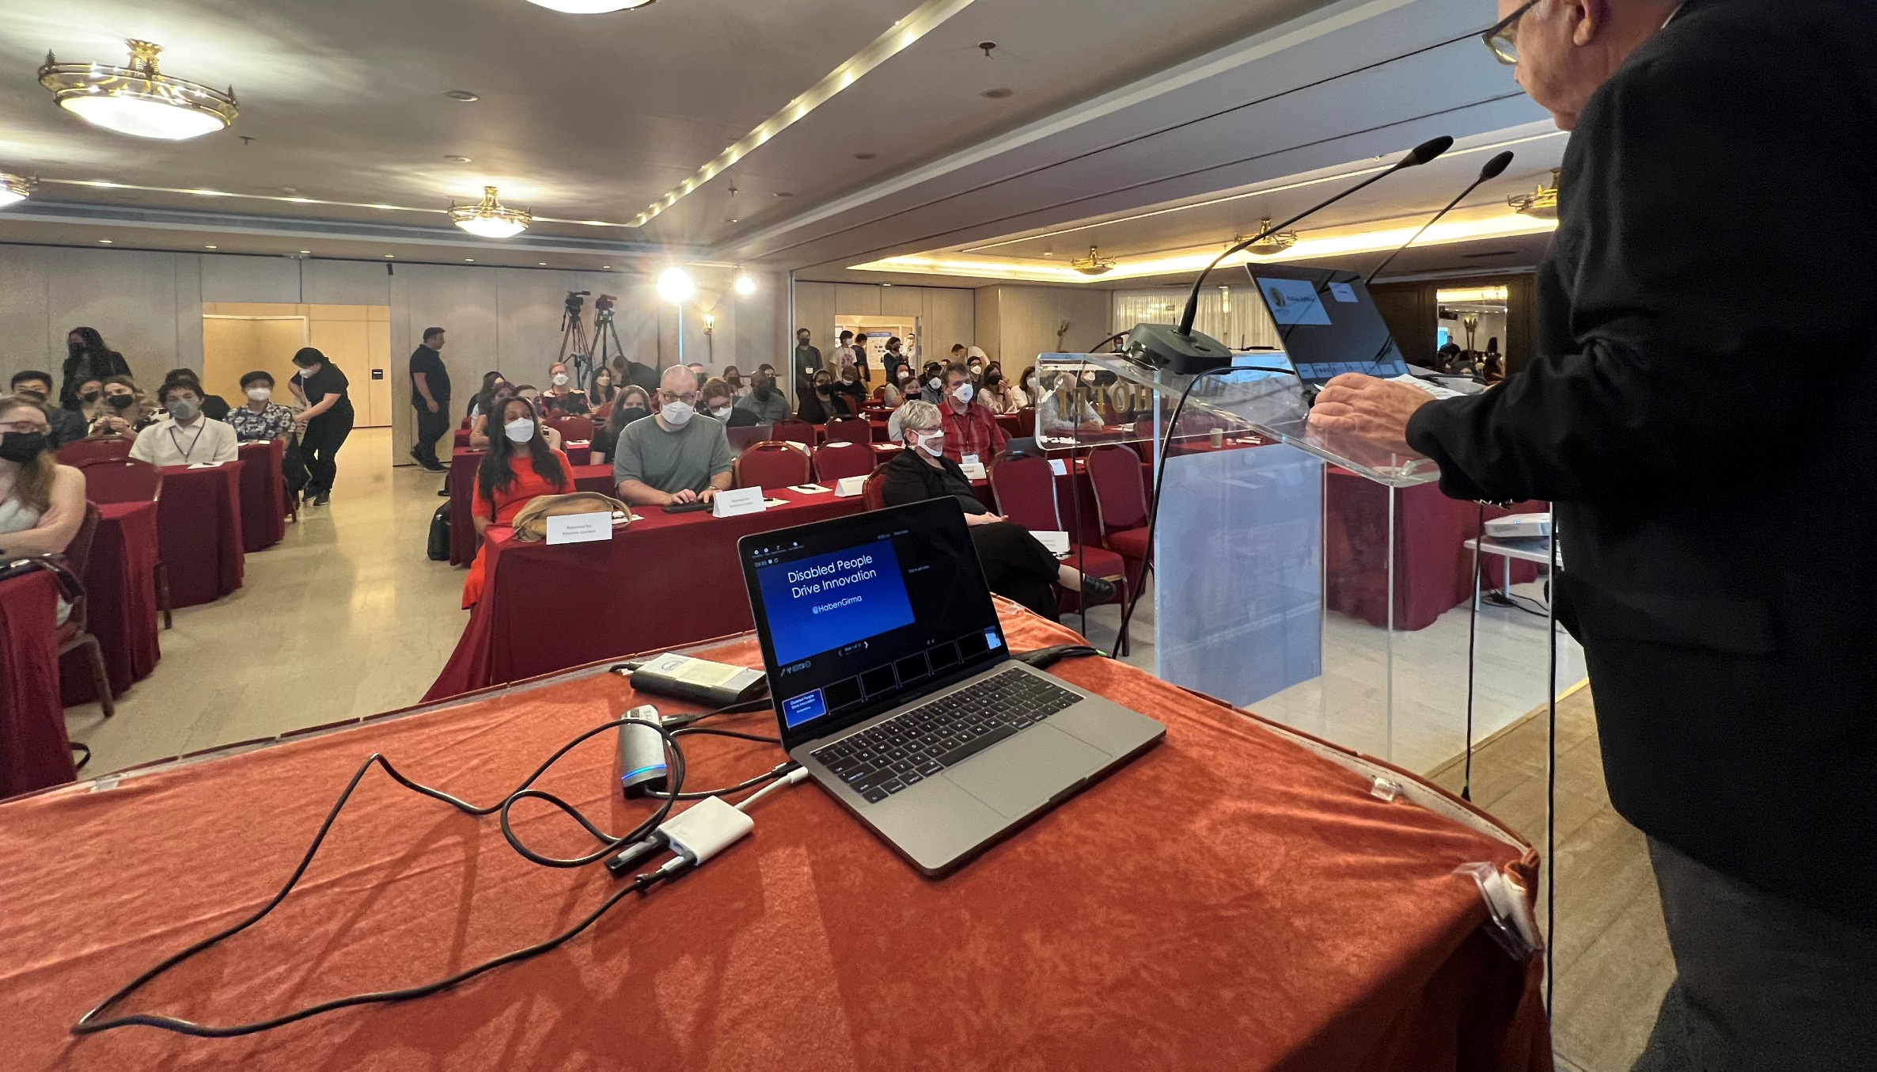
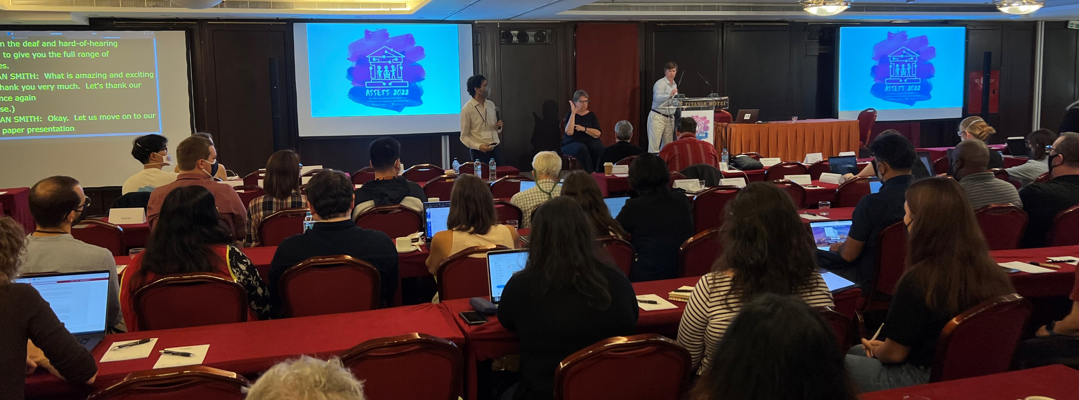
ASSETS’22 Day 1
Athens, Greece

Slide 3
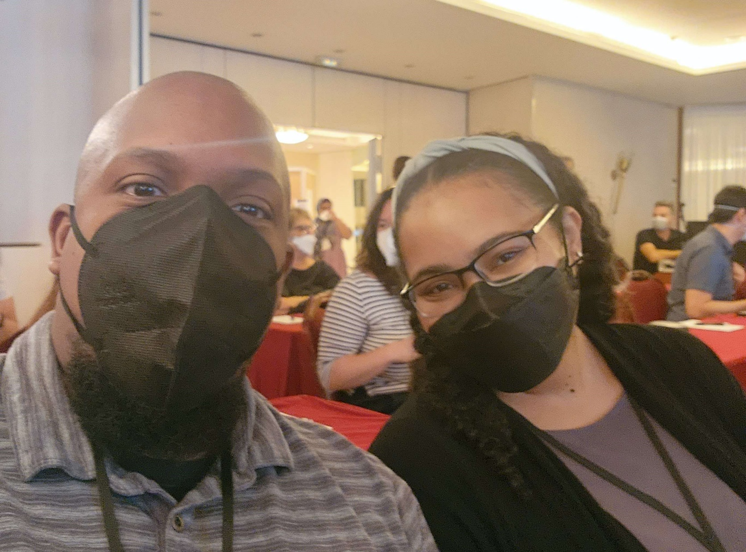
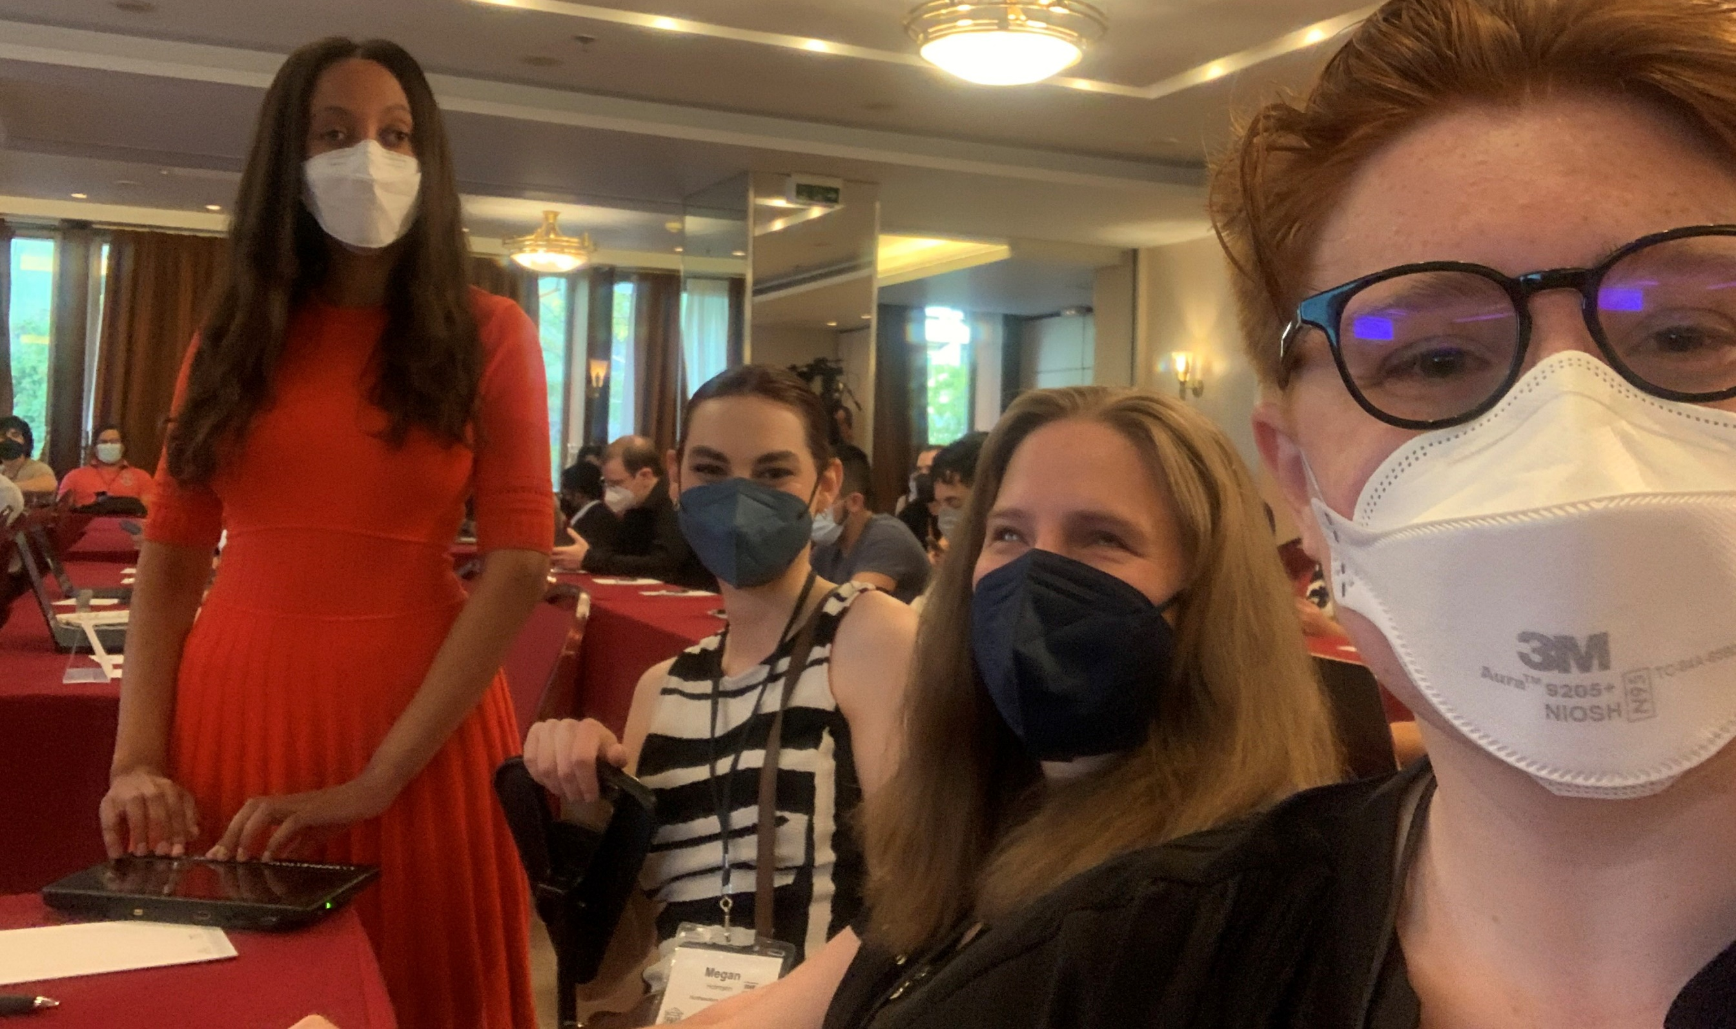
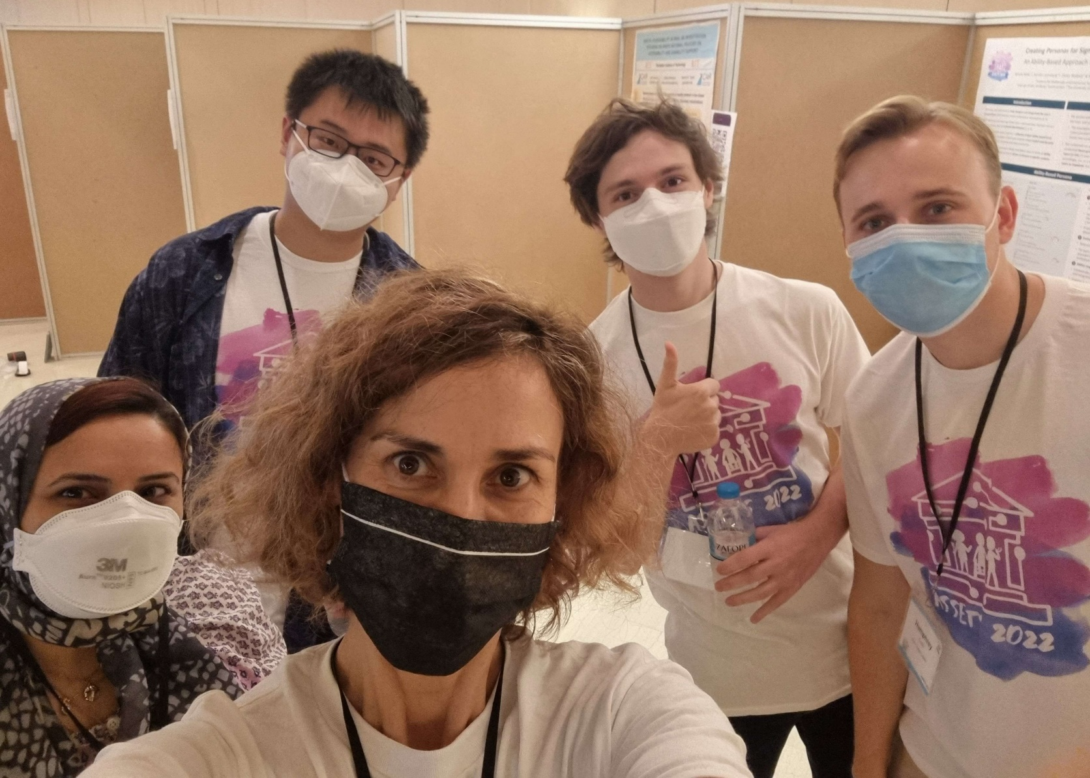
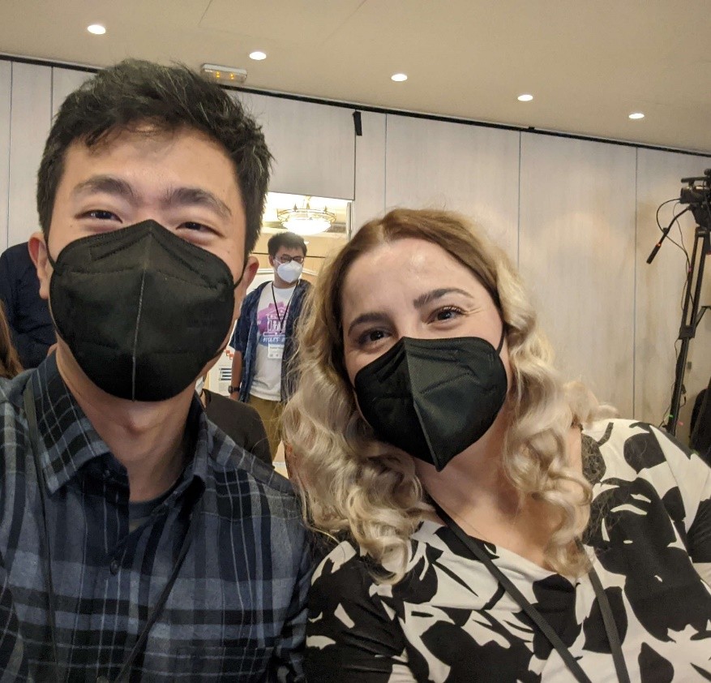
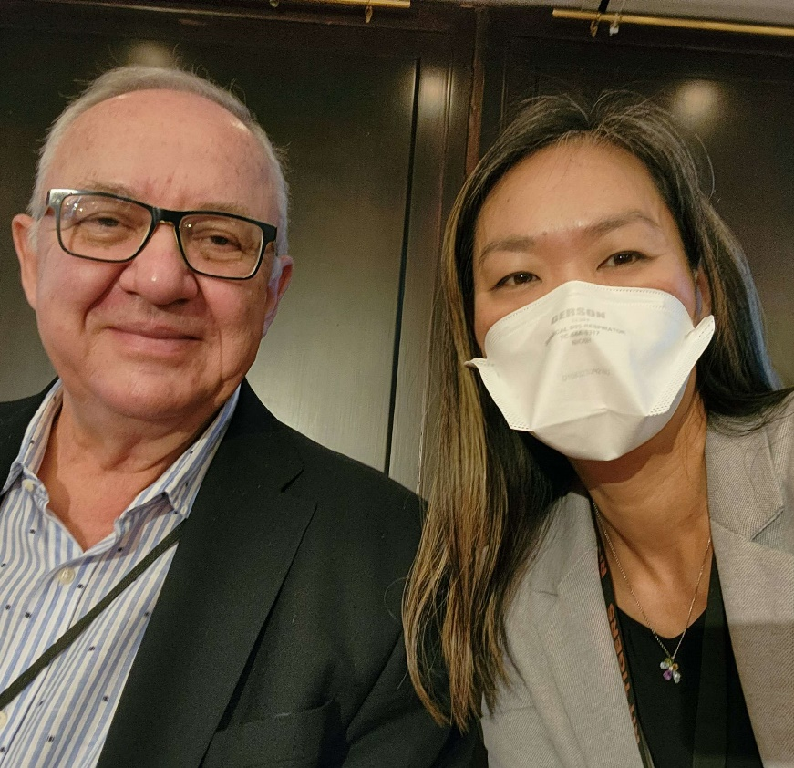
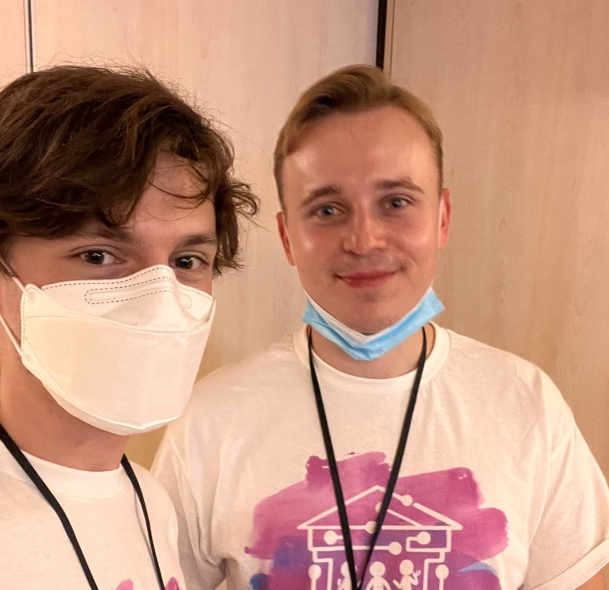
ASSETS’22 Day 1 Posters and Demos
ASSETS’22 Day 1
Posters & Demos
Notes:
And Discord was totally alive yesterday. Let’s keep it up!

Slide 4
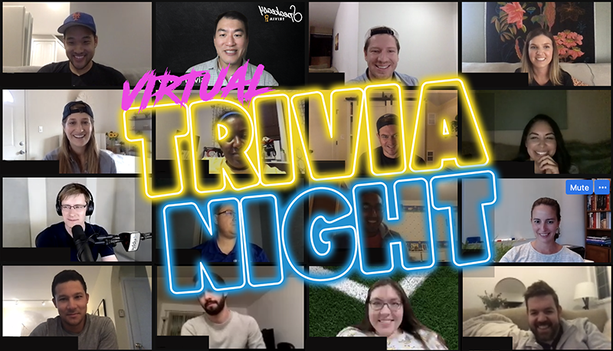
ASSETS’22 Day 1 Virtual Trivia
ASSETS’22 Day 1
Virtual Land

Slide 5
Notes:
Here’s a screenshot from the Discord channel with Momona Yamagami saying … ”Thanks so much…”

Slide 6
ASSETS’22 Day 1
#selfie channel
Notes:
And Discord was totally alive yesterday. Let’s keep it up!

Slide 7
Day 2
Notes:
We have a similarly exciting program for Day 2

Slide 8
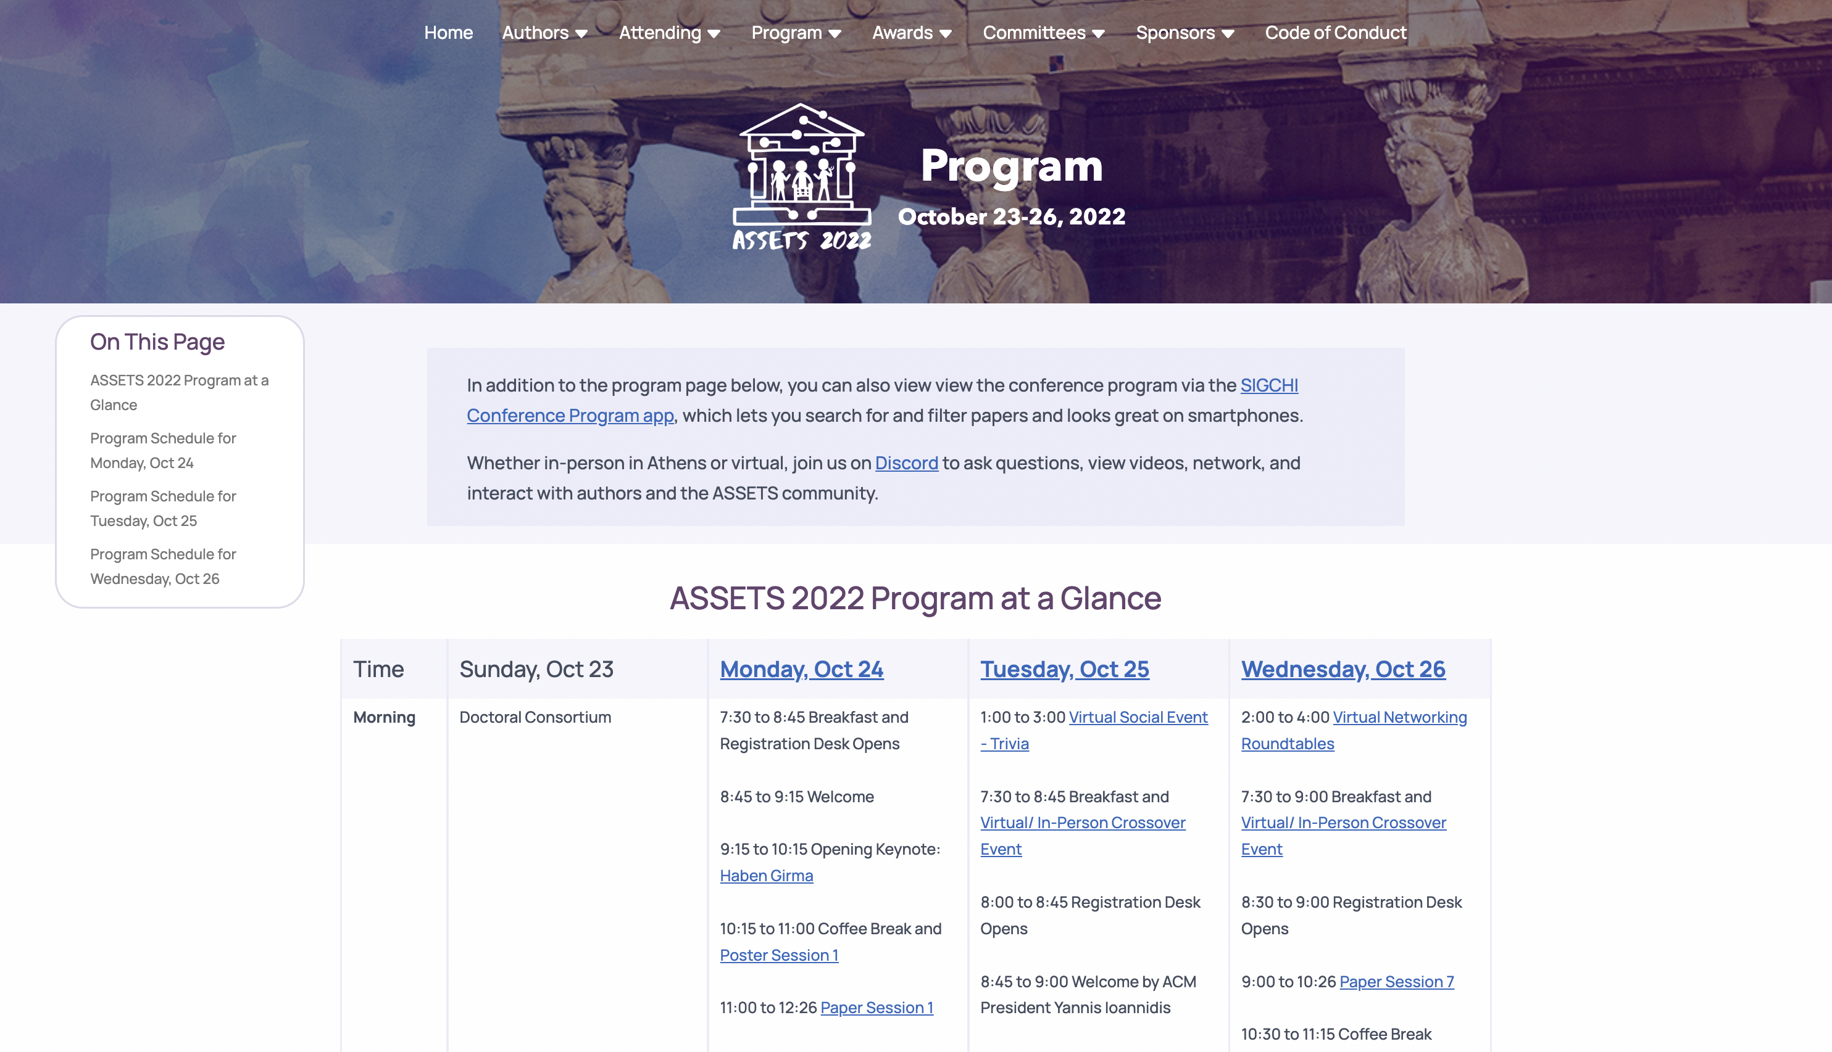
Website Program
https://assets22.sigaccess.org/program.html
Notes:
I encourage you to spend some time on the ASSETS’22 program website to get an overview of our schedule

Slide 9
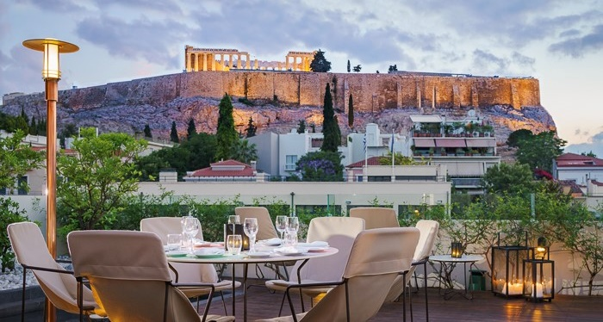
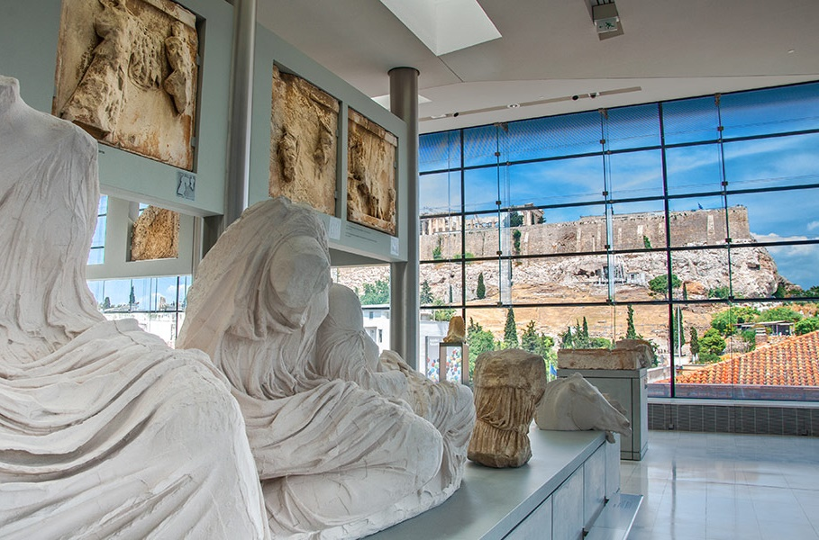
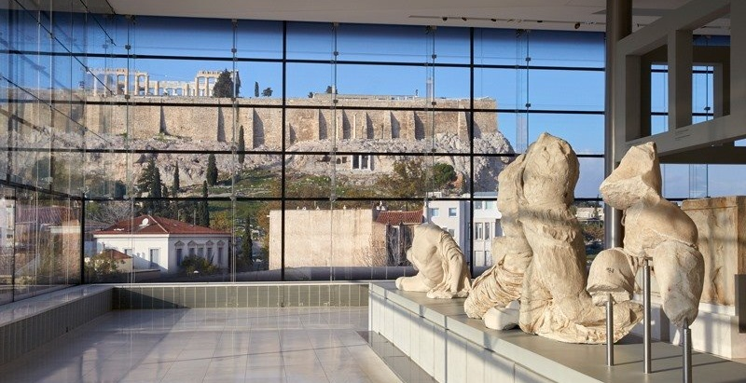
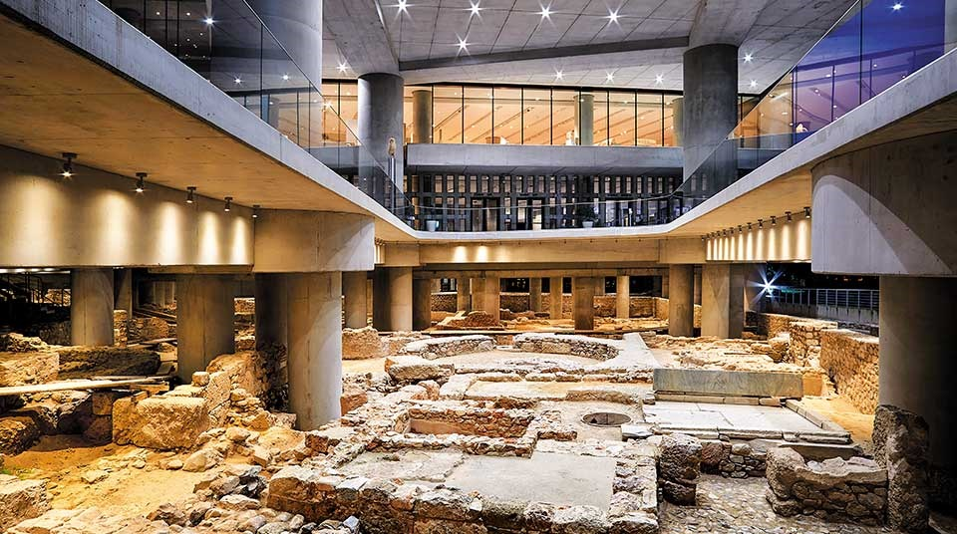
Acropolis Museum
Tues, Oct 25 | 20:00-23:30
Notes:
On Tuesday evening, we will go to the Acropolis Museum where will have private tours and a dinner

Slide 10
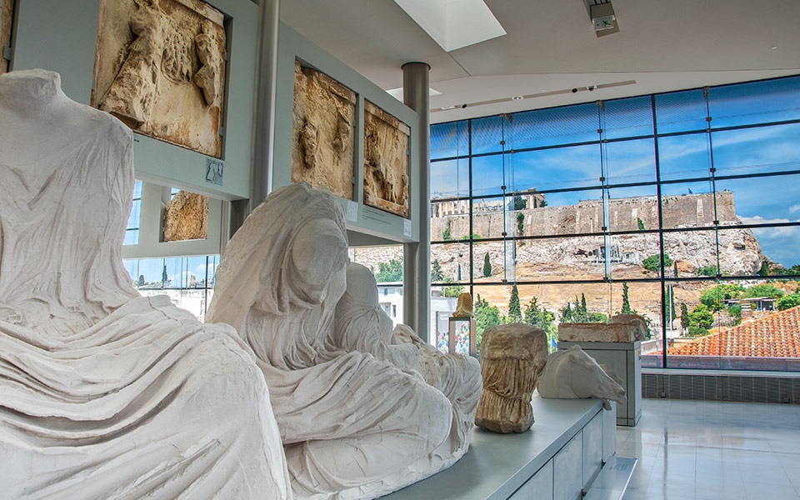
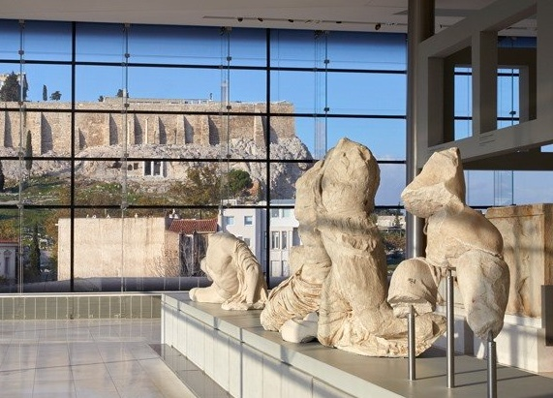
Acropolis Museum
Tues, Oct 25 | 20:00-23:30
The museum is ~2km away from Hotel Titania.
07:15PM Group leaves from hotel (optional)
07:50PM Arrive at Acropolis Museum
08:00PM Guided tours begin
09:00PM Eat at Acropolis Café
11:30PM Close
Please take dietary preference / requirement cards from registration desk.
Notes:
If you would like to go to the museum with a group, they will leave at 7:15 from the hotel. See Discord

Slide 11
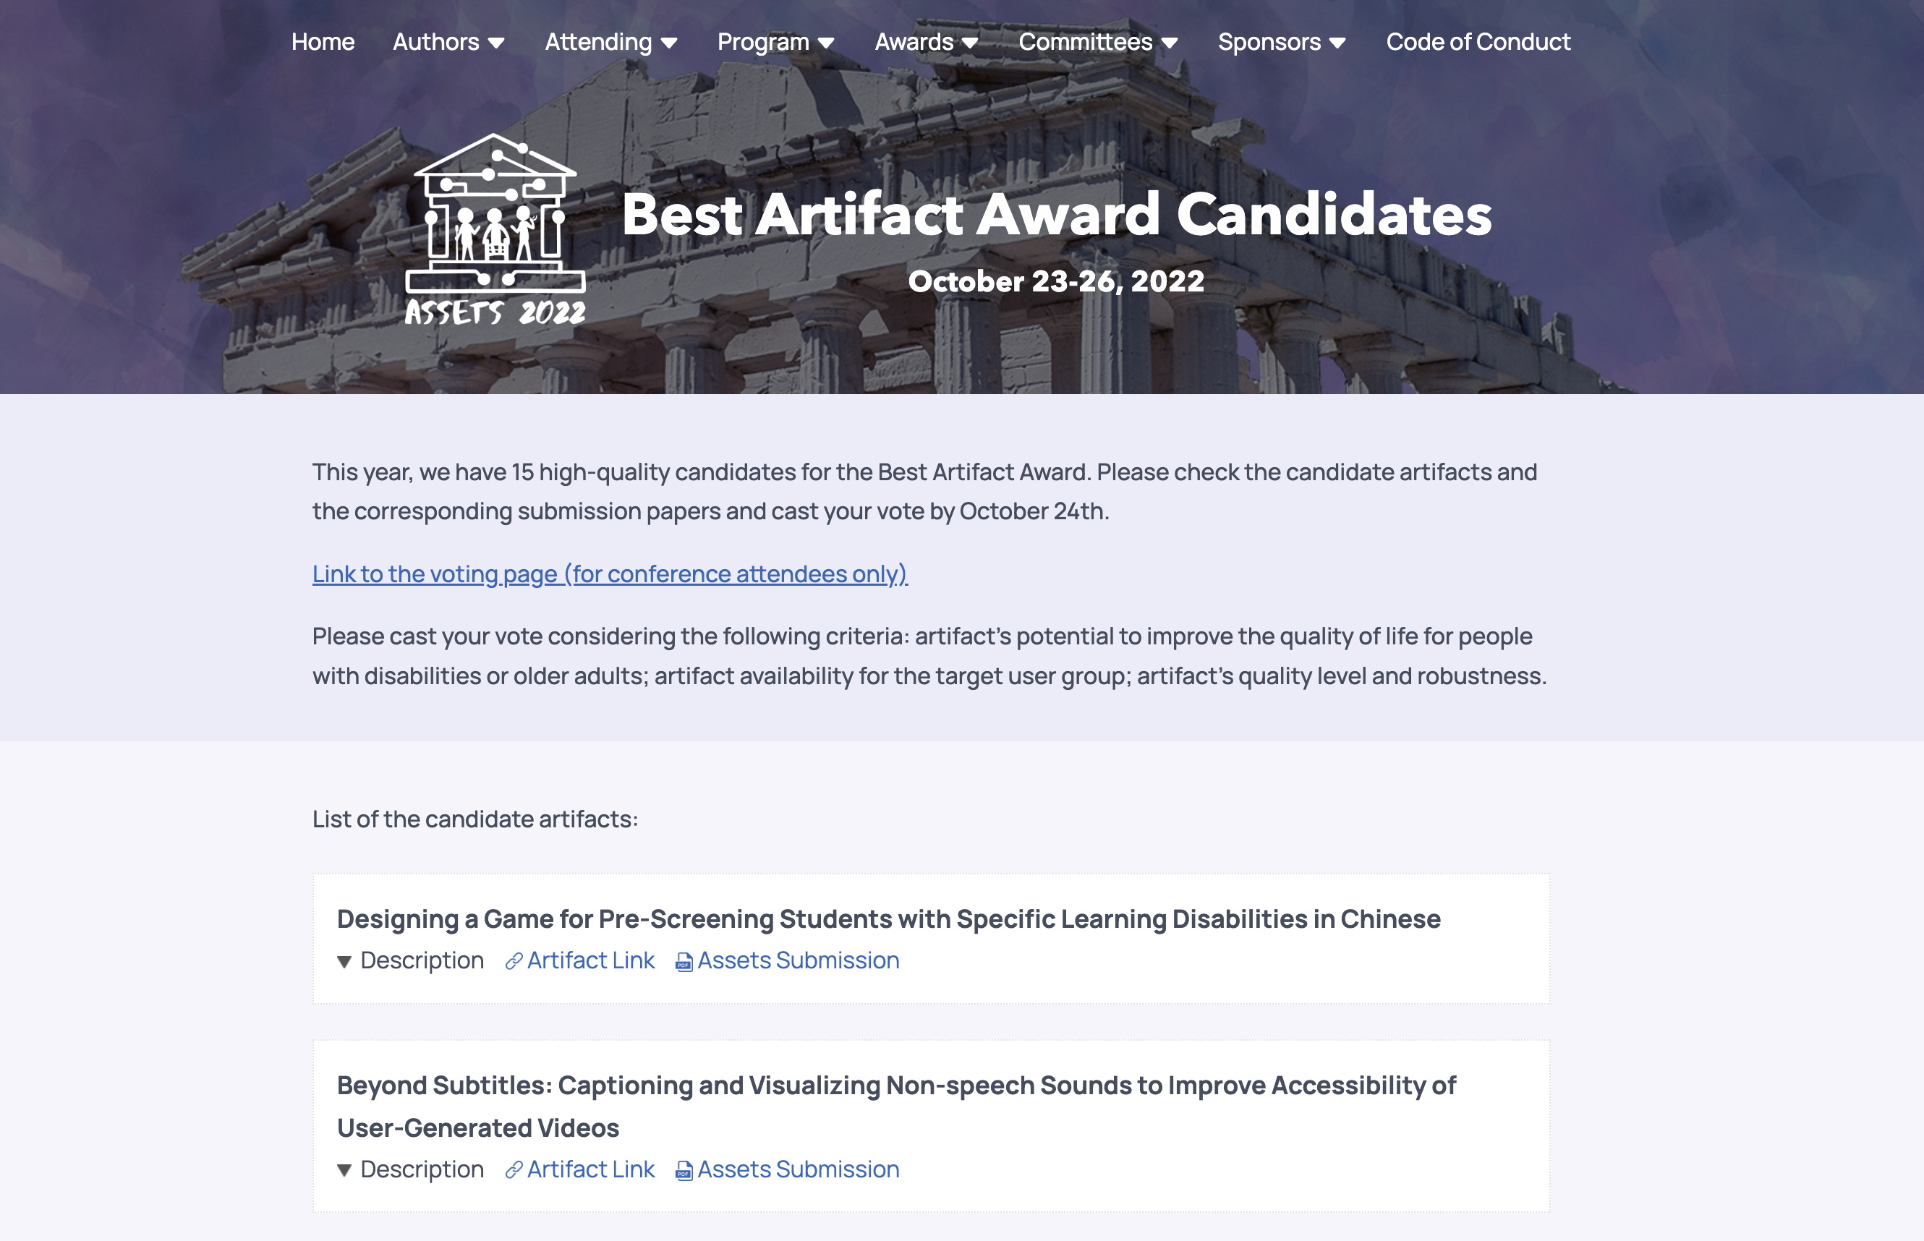
Vote Here by noon Athens time
Notes:
We’re happy to once again have a Best Artifact Award. Please vote for your choice of Best Artifact through the link on the conference web page
----
publicly available apps, data sets, commercial products, or open-source projects on the conference web page.
The Top-3 Best Artifacts will be selected based on the project’s contribution to the field of accessibility. A combination of delegate voting and input from a panel of judges will determine the winners.

Slide 12
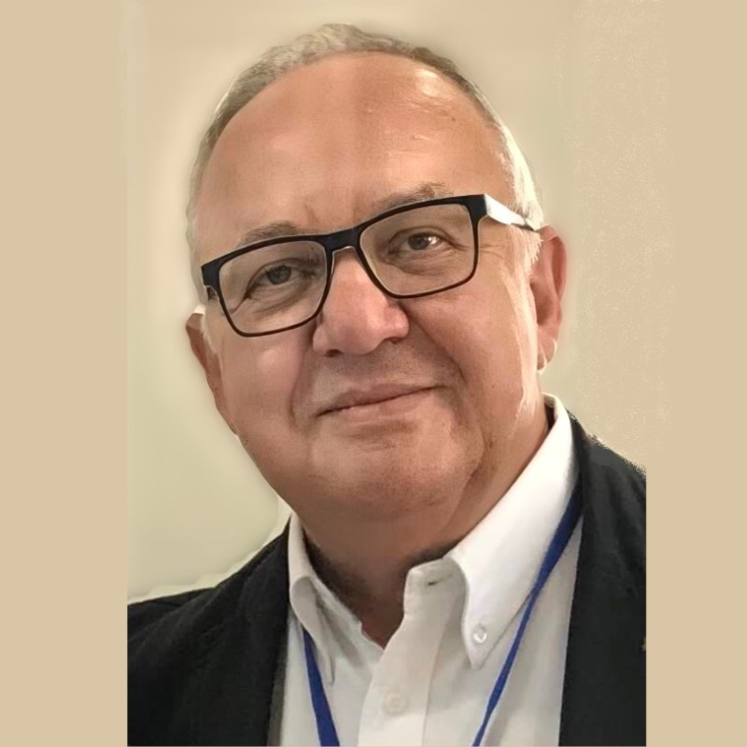
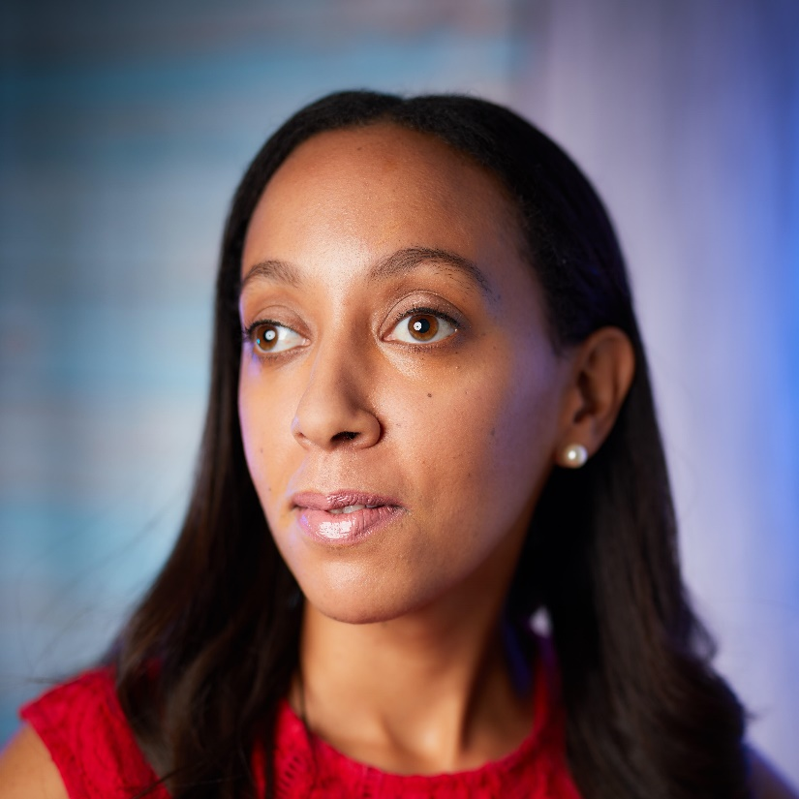
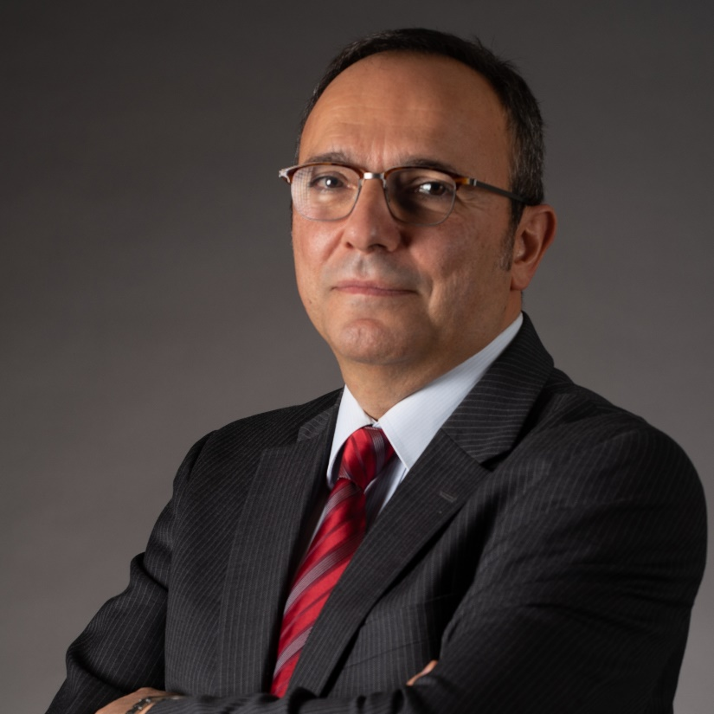
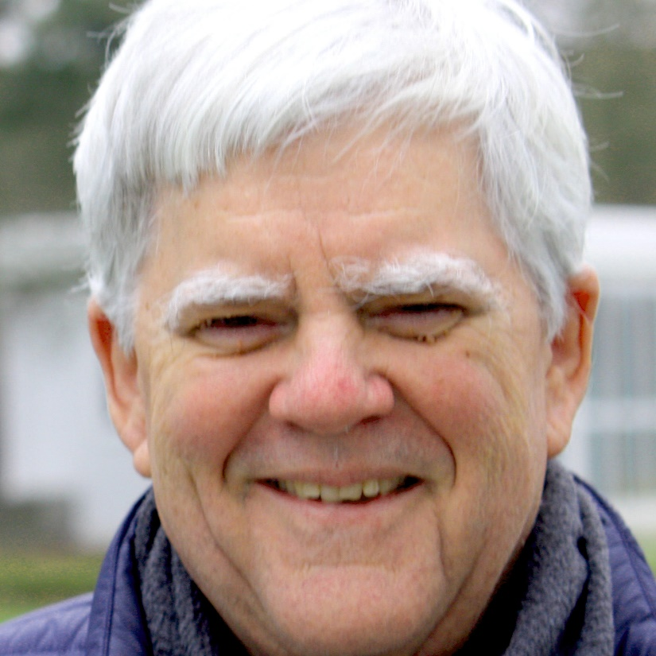
Distinguished guestS
schedule
Monday
Tuesday
Georgios Kouroupetroglou President, Advancement of Assistive Technology in Europe; Prof, NKUA
Haben Girma
Human rights lawyer advancing disability justice
Yannis Ioannidis President, ACM Professor, NKUA
Clayton Lewis Professor Emeritus, U. of Colorado SIGACCESS Outstanding Contribution
Notes:
Today begins with two distinguished guests: ACM President Yannis EE-O-A-Nee-Dis and SIGACCESS Outstanding Contribution Awardee Clayton Lewis

Slide 13
ACM President: Yannis Ioannidis
ASSETS’22 Day 2
President, Association for Computing Machinery
Professor, Informatics and Telecommunications, University of Athens
Former Director, Athena Research and Innovation Center
Accomplished scholar, Fellow of ACM/IEEE, VLDB “10-Year Best Paper Award”, NSF “Presidential Young Investigator Award”
Yannis Ioannidis President, ACM Professor, NKUA
Notes:
Yannis is a professor in Informatics and Telecommunications from the University of Athens and the Former Director of Athena Research and Innovation Center

Slide 14
Distinguished guestS
schedule
Monday
Tuesday
Georgios Kouroupetroglou President, Advancement of Assistive Technology in Europe; Prof, NKUA
Haben Girma
Human rights lawyer advancing disability justice
Yannis Ioannidis President, ACM Professor, NKUA
Clayton Lewis Professor Emeritus, U. of Colorado SIGACCESS Outstanding Contribution
Notes:
Today begins with two distinguished guests: ACM President Yannis EE-O-A-Nee-Dis and SIGACCESS Outstanding Contribution Awardee Clayton Lewis

Slide 15
SIGACCESS Award: Clayton Lewis
ASSETS’22 Day 2
Professor, University Colorado Boulder (1984-2021)
ACM SIGCHI Academy, 2009
ACM SIGCHI Social Impact Award, 2011
President’s Teaching Scholar, University of Colorado
Coleman Institute for Cognitive Disabilities, 2004-2011
Clayton Lewis Professor Emeritus, U. of Colorado SIGACCESS Outstanding Contribution
Notes:
Clayton was a professor at the University of Colorado Boulder from 1984-2021 and is a foundational member of our community
He has earned nearly every high accolade in the field of Human-Computer Interfaction including the ACM SIGCHI Academy, the ACM SIGCHI Social Impact Award
And he was also honored with the President’s Teaching Scholar at the Unviersity of Colorado, a lifetime award that is the university’s highest honor for teaching excellence
Lewis’s research related to cognitive disability is marked by his long-standing collaboration with, and recognition from, the Coleman Institute for Cognitive Disabilities, where he served as scientist in residence (2004-2011), as Coleman-Turner Professor in Computer Science (2018-2019), and as the institute’s co-director for technology (2019-2021).

Slide 16
Notes:
Professor Lewis has been a prolific contributor to SIGACCESS conferences and journals. He has published 8 articles at ASSETS and 4 in the SIGACCESS Newsletter, in addition to numerous other articles related to cognitive accessibility, accessible learning environments, and related topics
Professor Lewis has also supported the SIGACCESS community through numerous service roles, including serving as general chair for ASSETS 2013 and as SIGACCESS vice chair (2013-2015). Chair of research competition in 2006, co-chair of the doctoral consortium (in 2007 and 2011), o-chaired the ASSETS mentoring program in 2018 and 2019
At a personal level, Professor Lewis has always been a thoughtful, honest, and reliable colleague, mentor and friend, who cares deeply about how the computing field supports people of all backgrounds, and about developing future generations of computing professionals.

